Slide 1
Insights and forecast for next marketing campaign
Arjun Rajendra Gupta (B00899773)
Pramir K C (B00875260)
Rajkanwar Chopra (B00888102)

Slide 2



MEET THE TEAM
Arjun Rajendra Gupta
Pramir K C
Rajkanwar Chopra

Slide 3
Business problem
Conversion Ratio of the people subscribing to bank's term deposit is low (11.3%).
Resource constraints
To create great campaigns, marketing professionals often need data beyond secondary market research such as customer insights. However, they often lack time or budget to conduct primary research including focus groups.
Data Driven Support
To match marketing plans with actual campaign results, marketers not only need data support, but also need in-depth understanding of data gathered from previous campaign.
Actionable insights
To generate extraordinary ideas, creative experts not only need deeper insights about consumers, but also insights that can identify certain characters about certain consumers from others.
COSTS
To profit from the term deposit program, the corporation needs not only more clients who would subscribe, but also lower resource costs. Focusing on the targeted consumer groups with less resources, for example, will result in lower costs and more profits.

Slide 4
Dataset overview
20 input variables, 1 output variable ( if client subscribed to term deposit? (Y or N)
BANK CLIENT DATASET
Example: Age, job, marital status , loan
CONTACT DURING CURRENT CAMPAIGN
How and when the client was contacted during the current campaign, and long the call lasted.
OTHER ATTRIBUTES
It includes the outcome from the previous marketing campaign and how many times the client was contacted during this campaign.
SOCIO & ECONOMIC CONTEXT ATTRIBUTES
It indicates the economic indexes, employment rate and social indexes.

Slide 5
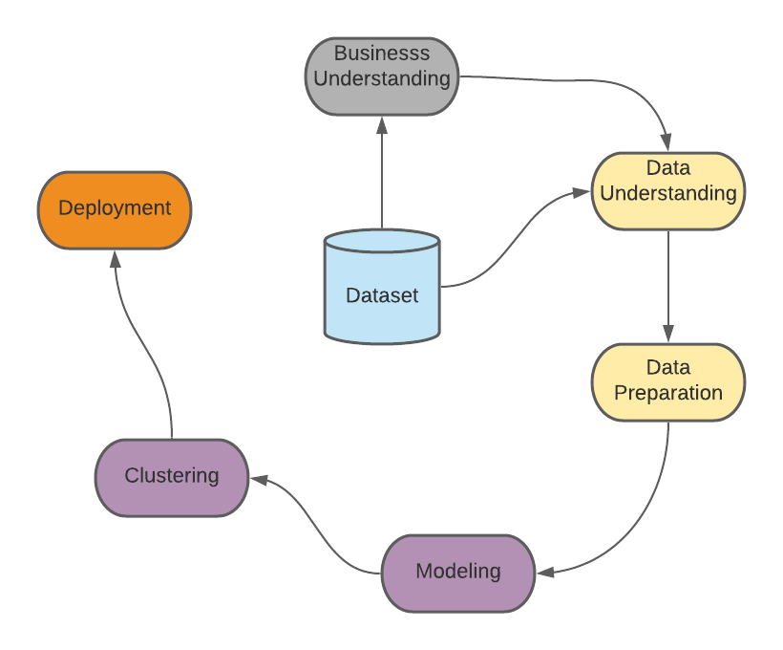
Process flow

Slide 6
Exploratory data Analysis

Slide 7
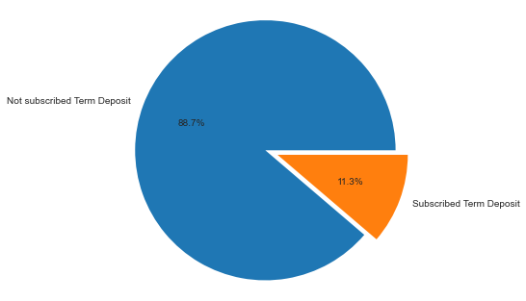
How many people subscribed to the term deposit in last campaign

Slide 8
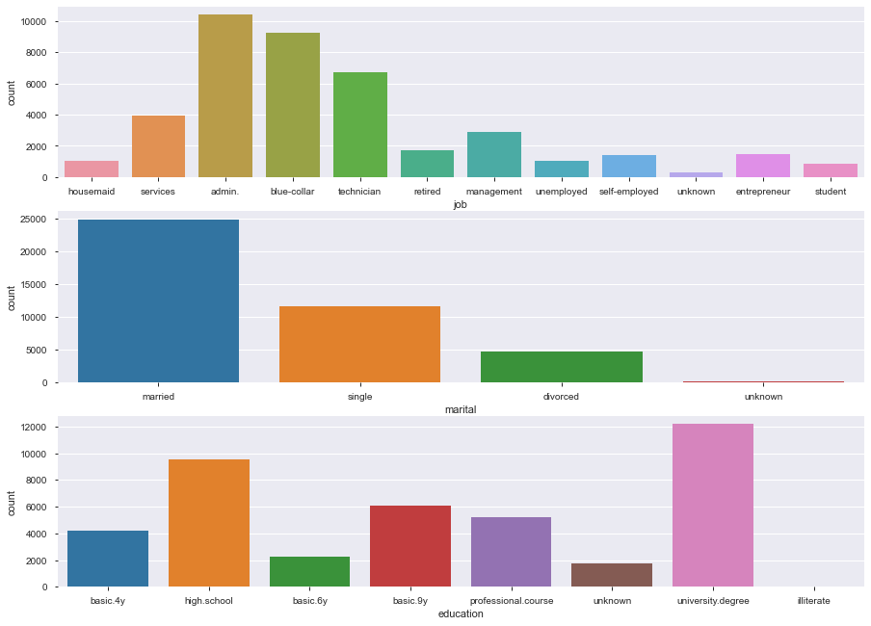
General observation from categorical columns
The customers in the campaign mostly included people employed in administration role, technicians or in blue collar jobs.
Most of the customers contacted are married.
Most customers contacted have passed High School or have a University Degree.

Slide 9
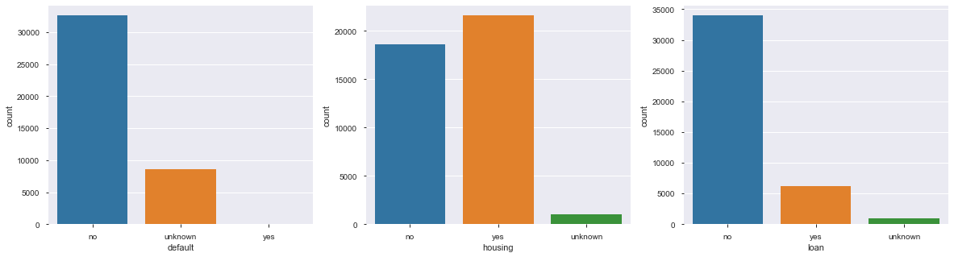
General observation from categorical columns
1. Most people have not defaulted on their personal loan
2. There are very less people having any other loan to their name apart from Home Loan.
3. Most people do not have any personal loan.

Slide 10
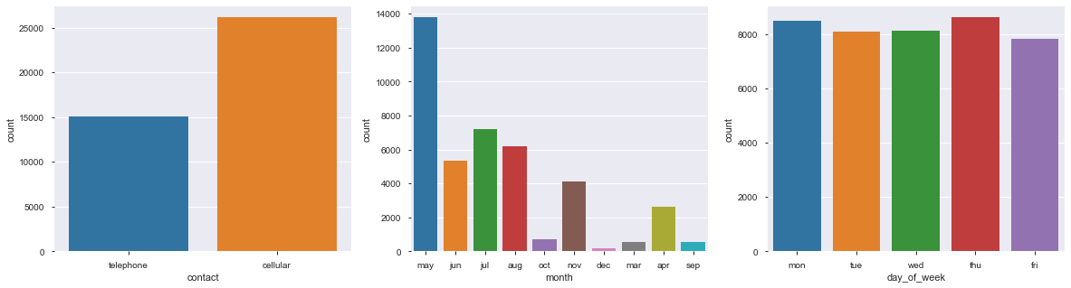
General observation from categorical columns
1. Most people were contacted over cell phone.
2. Most people were contacted in the month of May.
3. No trend is seen in day of the week.

Slide 11
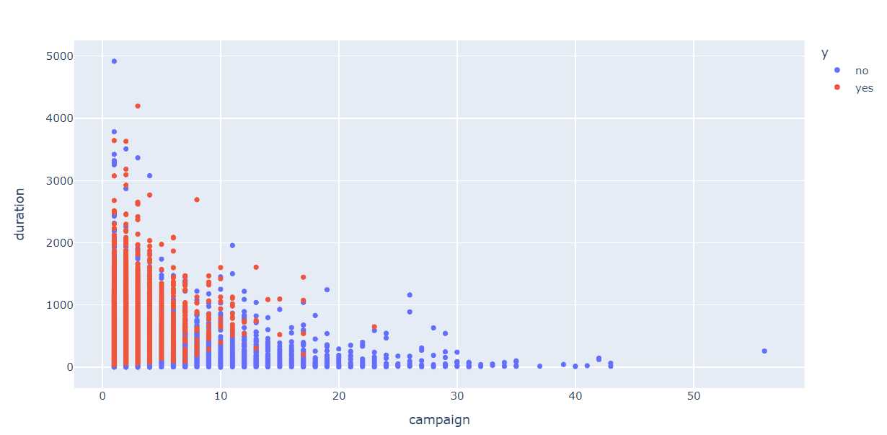
Relationship between duration of the call and number of times client was contacted

Slide 12
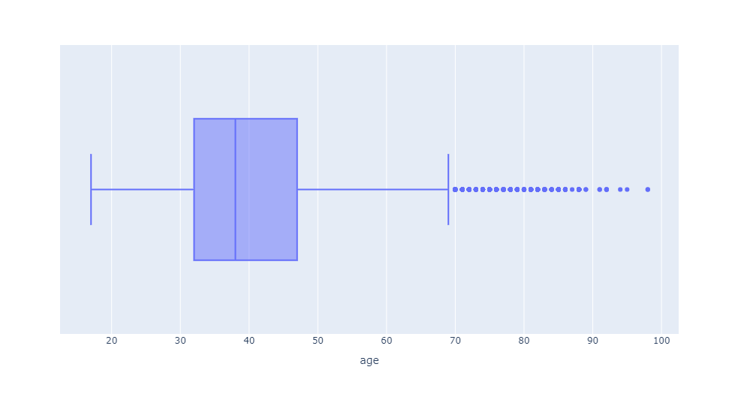
How senior citizens are good for the campaign
Age column has outliers. From box plot we can see that outliers are above the age of 70.
But there are more than 400 records for the age > 70
There are total of 40k rows approx. and out of which 11% subscribed to campaign that is 4.4k approx.
There are only 1% of people (469) who are more than 69 years of age. Now from this, 50% people have subscribed to it which is also the 5% of the total term deposits.
Hence it seems the elder and retired people have subscribed to the campaign most & and are important to the campaign

Slide 13
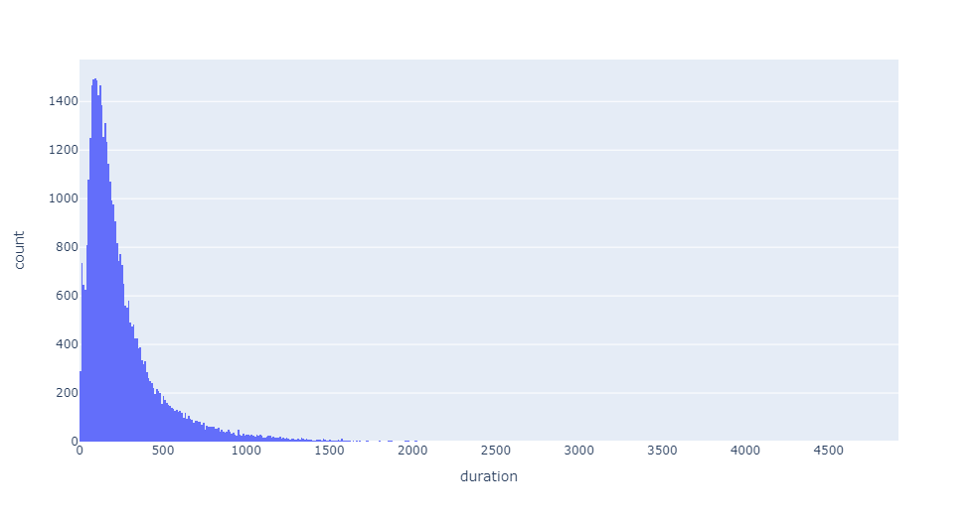
How long can you talk?

Slide 14
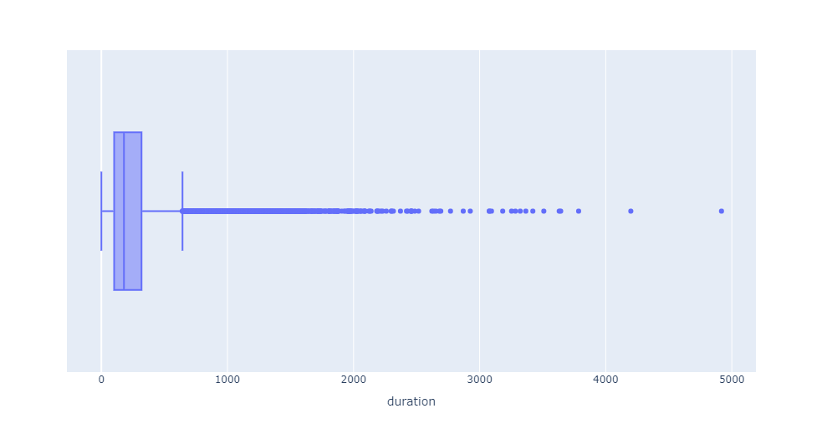
How Long can you talk?
Total Number of calls that lasted for more than 644 seconds – 2963
Call conversion rate for calls that lasted for more than 644 seconds - 1526
One thing to note here is as the number of duration increases the outcome y becoming yes increases too. More than 50 % of the people subscribed to term deposit for the calls that lasted than 644 seconds.

Slide 15
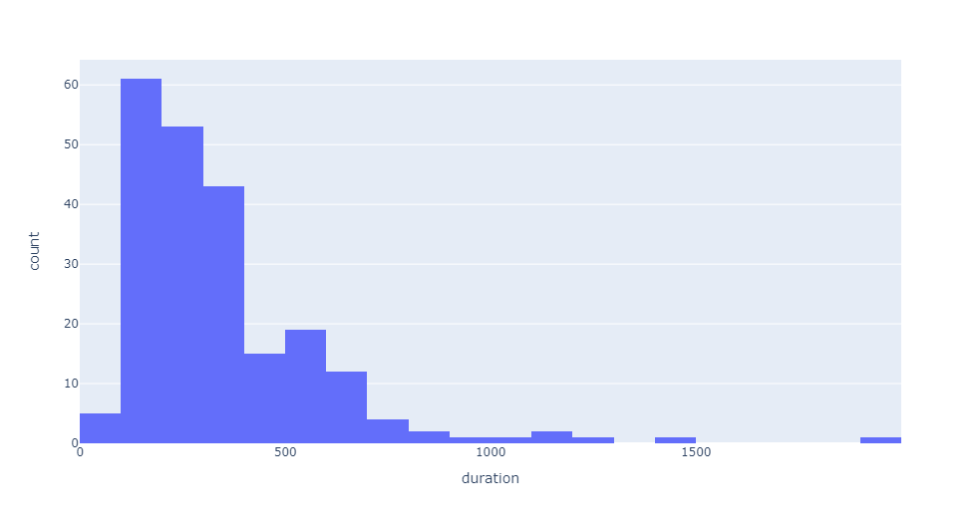
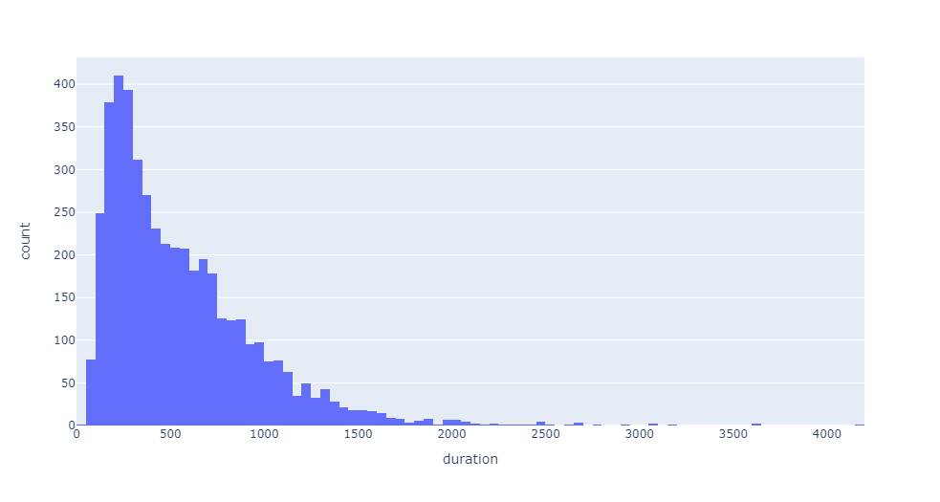
How long can you talk?
Left graph indicates, how long the call lasted for people who are more than 70 years of age and subscribed to term deposit.
Right graph indicates, how long the call lasted for whole dataset and people who subscribed to term deposit.
The persons who are more than 70 years of age does not talk much on phone and subscribe for the campaign, so the company can make strategies accordingly.

Slide 16
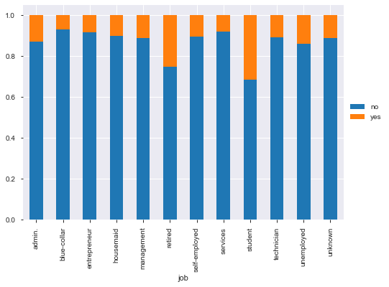
target Students or retirees
The conversion rate is very high for student and retired professionals and it lowest for blue-collar worker.

Slide 17
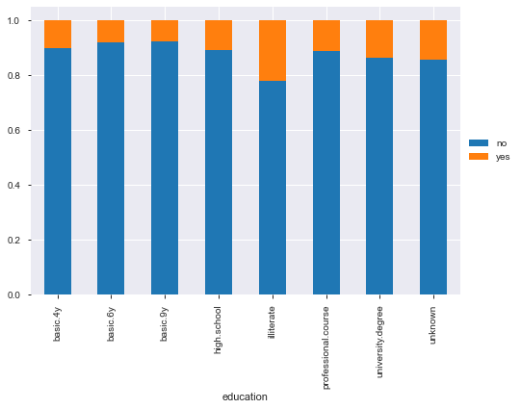
I do not know how to read or write!
Surprisingly, subscription ratio is highest for the people who are illiterate.

Slide 18
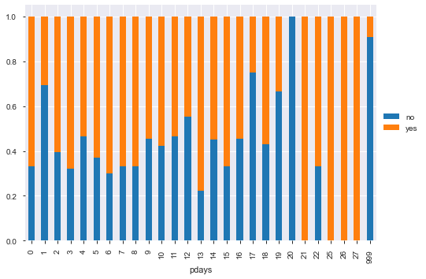
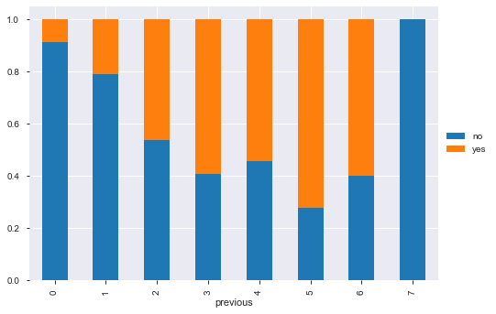
Shall we target customers from previous campaign?
If the client was contacted in previous campaign, then the client should be contacted in future campaigns too.
As the subscription ratio is much better if the client has been contacted in the past.
Also, the conversion rate was pretty good, if the client was contacted 3-6 times in previous campaigns.
Hence, company should design a strategy from previous campaigns too.

Slide 19
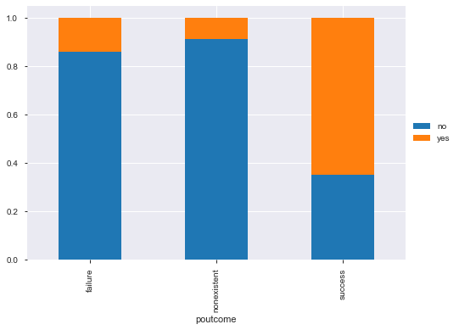
Shall we target customers from previous campaign?
Additionally, if the client has previously subscribed to company’s scheme in past then the clients are likely to subscribe in current campaign too.

Slide 20
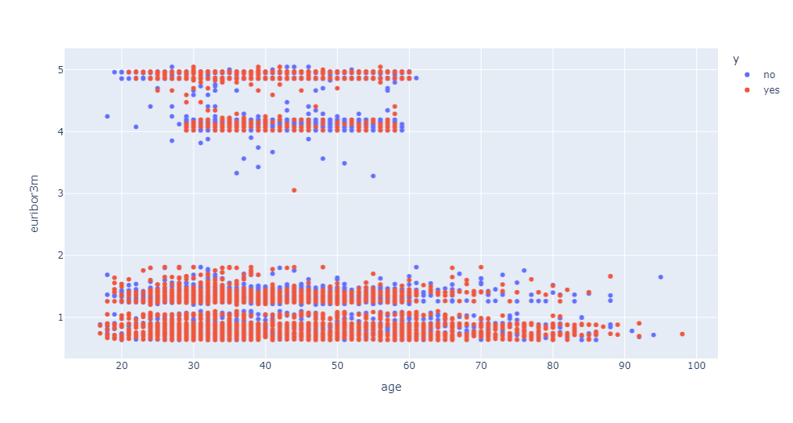
Pivotal role of socio-economic factors
It seems that People are subscribing to term deposit when the 3Month Euribor rate is low specifically below 2. That means, when the unsecured loan lending rate is low, at that time the returns on secured deposits are even lower. Since consumers do not get better return on other government backed deposits, they are likely to subscribe to special term deposits offered by banks.

Slide 21
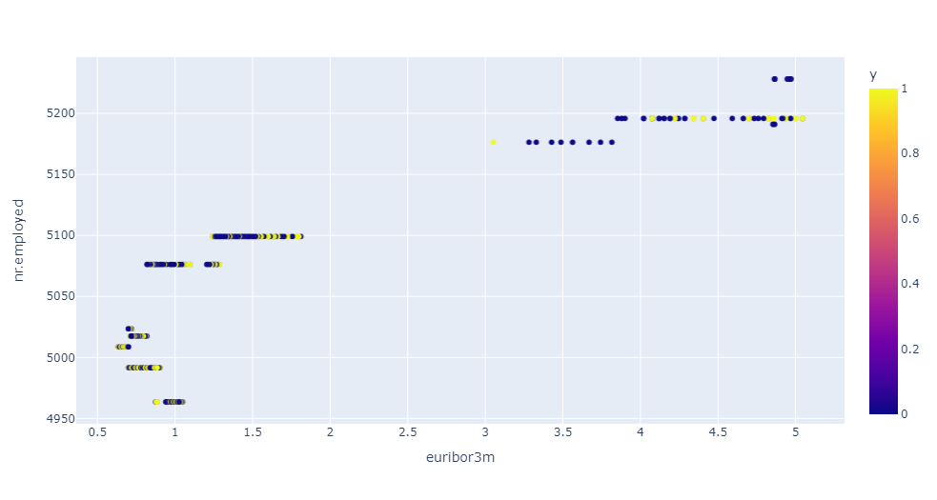
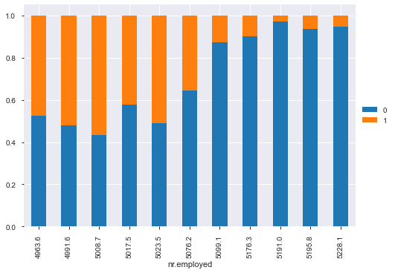
Pivotal role of socio-economic factors
When the economic cycle of the country is in expansion stage or at peak, then employment increases, that means that Euribor is at high too which leads to low subscription of term deposit and vice-versa

Slide 22
Application of machine learning

Slide 23
business problem → Machine Learning solution
Machine Learning will help us in forecasting the result of our next campaign for every customer.
This can be used as a base to develop strategy that targets every customer based on result obtained through our Machine Learning Model.
Key pattern recognition of customers
Higher revenue and profit
Increased productivity
Machine Learning

Slide 24
Strategy applied
Dataset
Highly Imbalanced
Accuracy?
Cannot be used
Trade-Off
Precision and Recall are important, but we need to make a trade-off to get the best possible metric for our scenario

Slide 25
deduction
False Negatives (FN)
FN is more important than FP for this campaign → F-Beta Score with Beta = 2
False Positives (FP)

Slide 26
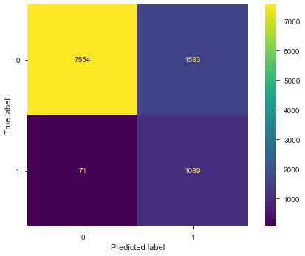
PREDICTING potential FUTURE CUSTOMERS
ML Model: Support Vector Machines
F-2 Score: 0.744
True Negatives: 7,554
True Positives: 1,089
False Positives: 1,583
False Negatives: 71
Total Test Data of Customers: 10,297

Slide 27
clustering

Slide 28
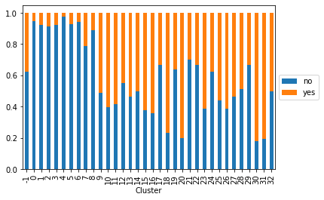
insights gathered
Finding certain customer group which has high conversion rate.
Combining the data of the clusters 20, 30 and 31 leads to a total count of 130 approx. and this data is giving us important insights related to profiles that were successfully subscribing to term deposit. We should ask marketing team to design a special strategy to focus on such profiles in order to gain a greater number of subscriptions.

Slide 29
Campaign direction
Frequency of contact – keep it between 3-6 calls/customer.
Duration of the call – try to keep the customer involved for more than 10 minutes.
Target elderly group – talk less and high subscription ratio.
Target students and illiterate group – their subscription ratio is higher too.
Special strategy required for blue-collar workers and entrepreneurs as they subscribe less.
People who have not yet defaulted on any loan repayment are likely to subscribe.
Try contacting customers over cell phone than telephone.
Try contacting customers from last campaign and clients who subscribed to the previous campaign – subscription ratio is higher.
Try launching the campaign when the Euribor rate is lower.

Slide 30
THANK YOU

